Slide 1
DATA ANALYSIS
BY -
ANISH SHUKLA

Slide 2
HOW I USED DATA?
I have used Jupyter Notebook to get the values and plot the dataset on the basis of many different parameters and to analyse data.
The libraries I used for it are:-
numpy
pandas
matplotlib
sklearn
I then did the preprocessing by making the dataset into numpy format for analysing the data. I used mean values to fill the missing values in the dataset.
The findings of my analysis is explained from the next slide onwards.

Slide 3
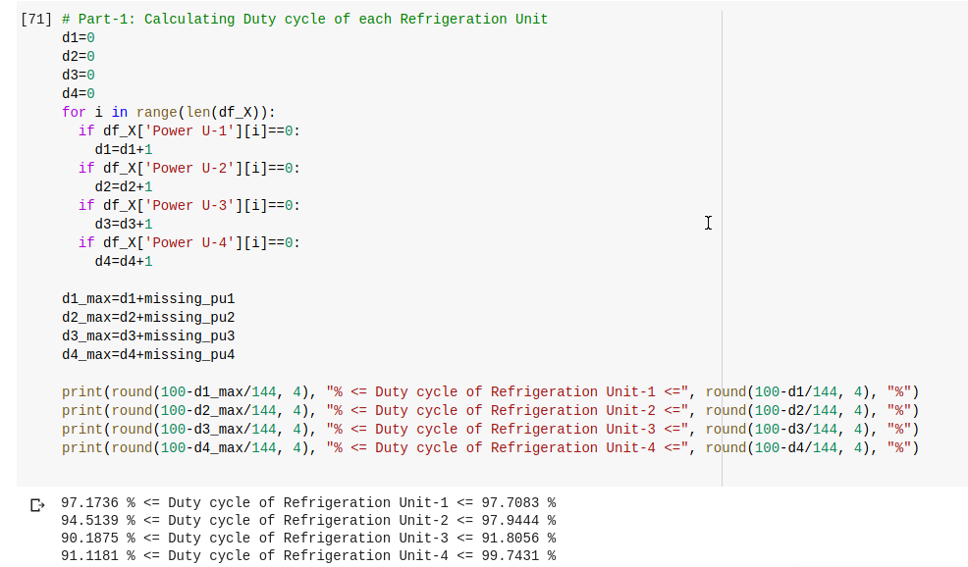
PART - 1: DUTY CYCLE
1.1 Duty Cycle Calculation

Slide 4

DUTY CYCLE ANALYSIS
The minimum value of Duty Cycle of Refrigeration Units is calculated by assuming that all the missing values are ‘zero’ and the maximum value is calculated by filling the missing values with the mean value per unit (i.e. No missing value is ‘zero’ in this case as the mean for every unit is non-zero). For the first case count of missing value was done and for the later filling of missing value was done with the help of imputer.

Slide 5
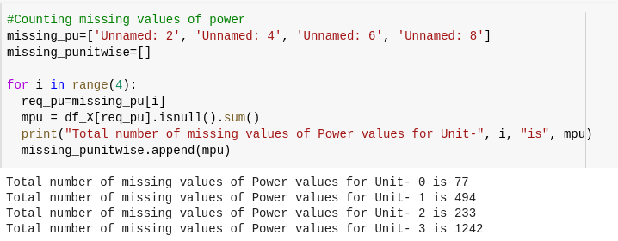

1.3 Counting no. of missing value per unit
1.4 Filling of missing data

Slide 6
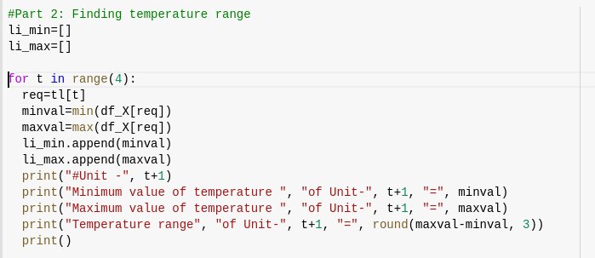
PART - 2: TEMPERATURE RANGE
2.1 Code for finding min, max and range of Temperature

Slide 7
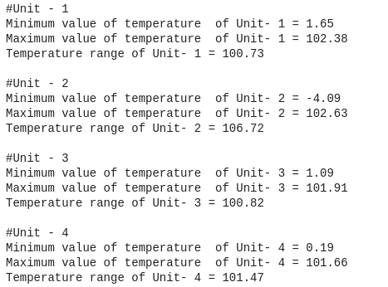
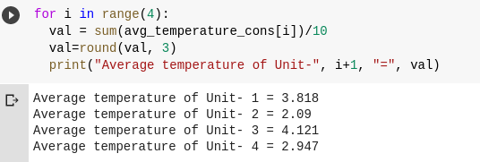
2.2 Min, Max, Range of Temperature
2.3 Average value of Temperature per unit

Slide 8
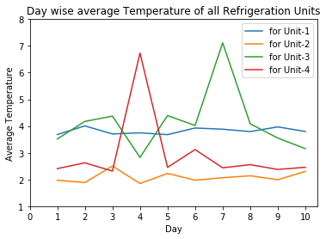
PLOT OF TEMPERATURE ANALYSIS
ANALYSIS OF THE PLOT
Here, we can clearly see that yellow curve i.e. Unit-2 has the best average daily temperature as it’s range is always between 1 and 3. So, the refrigerator is always maintained at a good temperature and better then rest of the units when compared on the basis of average daily temperature. The spike of red curve i.e. Unit-4 on day-4 is a very poor temperature as it is much higher than ideal temperature range. Similarly, green curve has a spike and also highly uneven daily average.

Slide 9
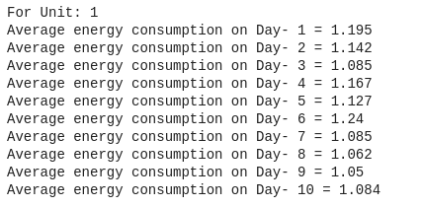
PART - 3: AVERAGE DAILY ENERGY CONSUMPTION
3.1: Unit-1 Energy Consumption

Slide 10
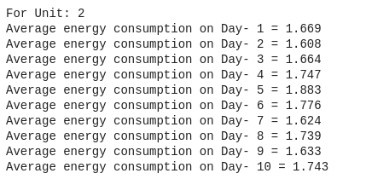
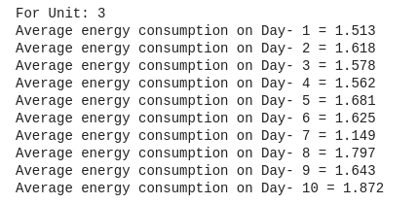
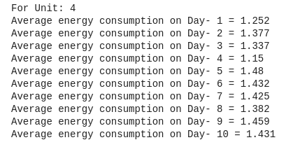
3.2: Unit-2 Energy Consumption
3.3: Unit-3 Energy Consumption
3.4: Unit-4 Energy Consumption

Slide 11
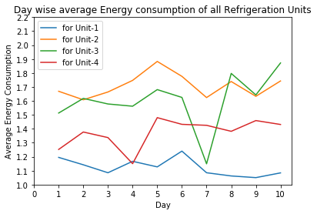
PLOT OF ENERGY ANALYSIS
PLOT OF TEMPERATURE A ANALYSIS OF PLOTY S
This plot represent average energy consumption for all the 10 days by all the 4 units. Average energy consumption is very low in case of blue curve ie Unit-1 followed by Unit-4. So, if we want to choose on the basis of energy efficiency we’ll any day choose Unit-1 over the rest.

Slide 12
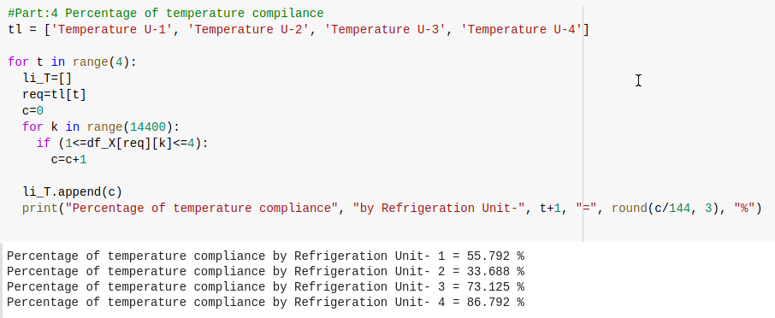
PART - 4: PERCENTAGE OF TEMPERATURE COMPLIANCE

Slide 13

ANALYSIS OF TEMPERATURE COMPLIANCE
Above mentioned are the values of Percentage of temperature compliance of all the Refrigeration Unit when the ideal temperature range is defined between 1 and 4. Unit-4 has the best temperature compliance that means the values of Unit-4 are most of the times in between the ideal range followed by Unit-3 which is in return followed by Unit-1. The values of Unit-2 are not very frequently between Ideal range and hence is performing worst in terms of temperature compliance.

Slide 14
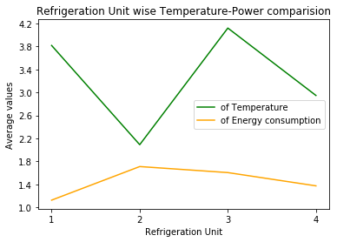
ADDITIONAL ANALYSIS TEMPERATURE-POWER COMPARISON
This represents the net average temperature and energy consumption of all the 4 units i.e. average value for all the 10 day for all the 4 units. Looking at this we get to know that average temperature of all the units except Unit-3 is in the ideal range. The temperature value is minimum for Unit-2. So, if we want to store something on an average temperature value less than 2 we’ll keep that thing in Unit-2 but energy consumption of unit 2 is highest. Unit-1 has lowest energy consumption and the average temperature is in the ideal range.
Unit-4 has 2nd lowest temperature average value and 2nd lowest energy consumption value in this plot.

Slide 15
CONCLUSION
The results on the basis of 4 criteria are:-
DUTY CYCLE :- UNIT-1 has best average case duty cycle and UNIT-4 has best value for best case of duty cycle(i.e. Ha best performance when all missing value is filled with mean value.)
TEMPERATURE RANGE :- Except UNIT-3 all the others had the average value of temperature for 10 days data between the ideal range. Also, Unit-1 has minimum range and Unit-2 has maximum range.
AVERAGE DAILY ENERGY CONSUMPTION:- Unit-1 performed best in that aspect as it had lowest average value on almost all day. It was followed by Unit-4.
PERCENTAGE OF TEMPERATURE COMPLIANCE:- Unit 4 performed best on this aspect as it had highest percentage ie highest number of values within the ideal range. Unit-2 had the lowest value which means has lowest number of values within the ideal range.
So, if we don’t want to spend much on power supply we can go for Unit-1 also UNIT-1 has minimum temperature range which means minimum fluctuations.
Unit-4 on the other hand is very close to average value of ideal range and has 2nd lowest energy consumption also Unit-4 showed best performance on Temperature Compliance. Moreover, Unit-4 has the best value for best case of Duty Cycle. Additionally, UNIT-4 performed best on Temperature Compliance. So, it’ll be wiser choice to choose Unit-4 any day above other if we want our system to be mostly in ideal temperature range for less expenditure on energy.

